Slide 1
Shell Bootcamp 2024 3 Reflections for Week 3
Avni Tonger
Date : 14-Sept-2024

Slide 2

About Me
“The day you plant the seed, is not the day you eat the fruit”
Please share an image / visual that best represents you

Slide 3

My learnings from this week! – Advanced Technical skills
WEEK - 3

Slide 4
Learning 1 | Azure VM
Scalability and Performance:
Choose the Right VM Size: Select VM sizes based on your workload requirements, considering factors like CPU, memory, and disk IOPS1.
Use Scale Sets: Azure Virtual Machine Scale Sets allow you to manage and scale multiple VMs automatically, ensuring high availability and performance2.
Security and Compliance:
Network Security: Implement Network Security Groups (NSGs) to control inbound and outbound traffic to your VMs. Use Azure Bastion for secure and seamless RDP/SSH connectivity1.
Data Protection: Encrypt your VM disks using Azure Disk Encryption and store sensitive information in Azure Key Vault1.
Cost Management:
Optimize Costs: Use Azure Cost Management and Billing tools to monitor and optimize your VM costs. Consider using reserved instances for long-term workloads to save on costs2.
Auto-Shutdown: Enable auto-shutdown for non-critical VMs to reduce costs during off-hours3

Slide 5
Learning 2 | Docker takeaways
Efficient Resource Utilization: Docker containers share the host OS kernel, making them lightweight and efficient compared to traditional virtual machines. This allows for better resource utilization and faster startup times1.
Portability and Consistency: Docker containers ensure that your application runs the same way regardless of the environment. This portability eliminates the “it works on my machine” problem, making it easier to move applications between development, testing, and production environments1.
Simplified Dependency Management: Docker allows you to package your application along with all its dependencies into a single container image. This simplifies dependency management and ensures that all required libraries and tools are included, reducing the chances of missing dependencies1.

Slide 6
Learning 3 | AWS takeaways
Comprehensive Cloud Services:
AWS offers a wide range of cloud services, including computing power, storage options, and networking capabilities. This allows you to build, deploy, and manage applications with ease, leveraging services like EC2 for virtual servers, S3 for storage, and RDS for managed databases1.
Scalability and Flexibility:
One of the major advantages of AWS is its ability to scale resources up or down based on demand. This flexibility ensures that you only pay for what you use, making it cost-effective for businesses of all sizes2. Services like Auto Scaling and Elastic Load Balancing help maintain performance and availability.
Security and Compliance:
AWS provides robust security features, including encryption, identity and access management, and compliance certifications. This ensures that your data and applications are secure and meet regulatory requirements3. AWS’s shared responsibility model clarifies the security responsibilities between AWS and the user.

Slide 7
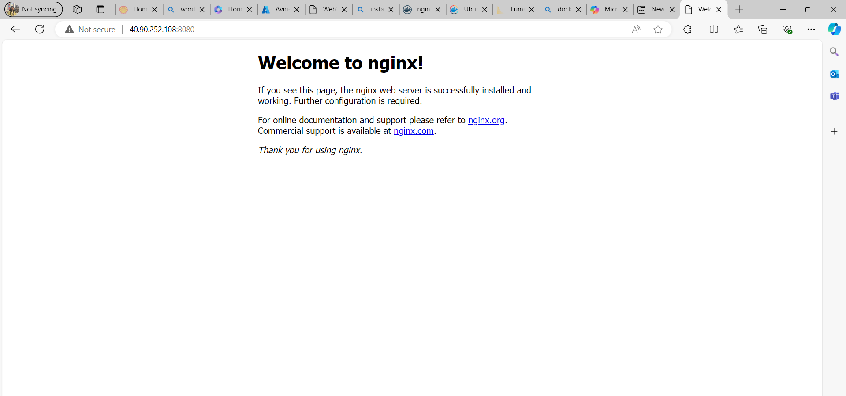

Slide 8
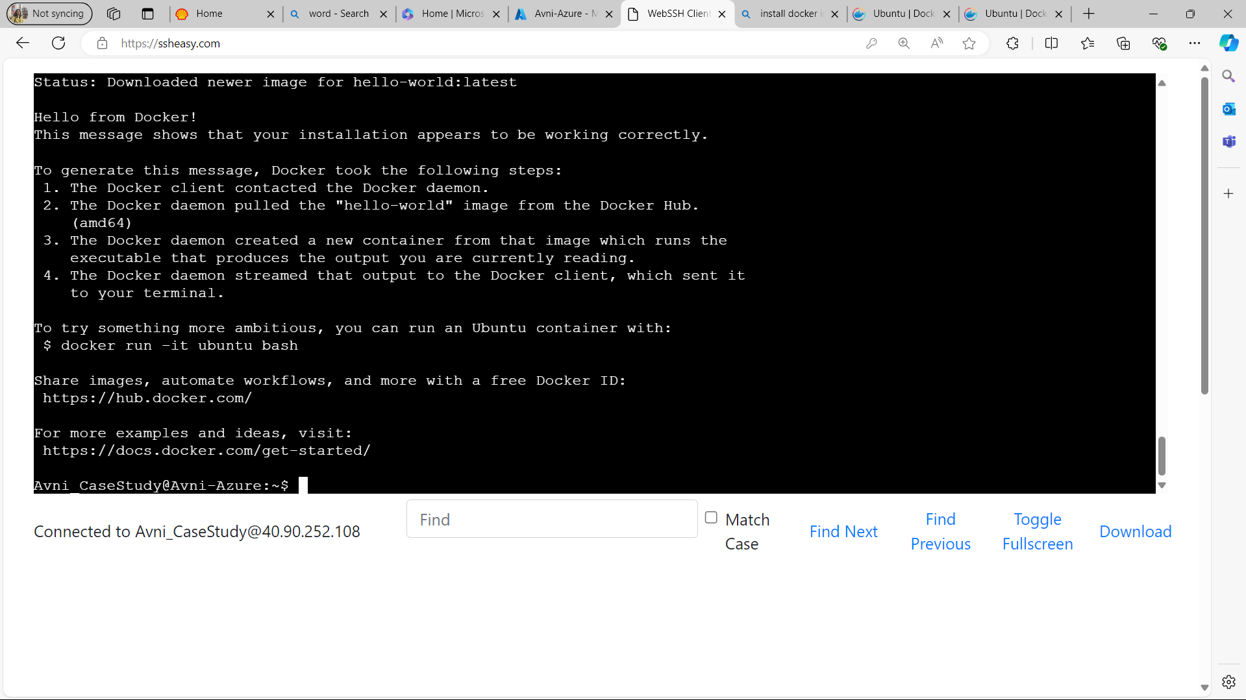

Slide 9
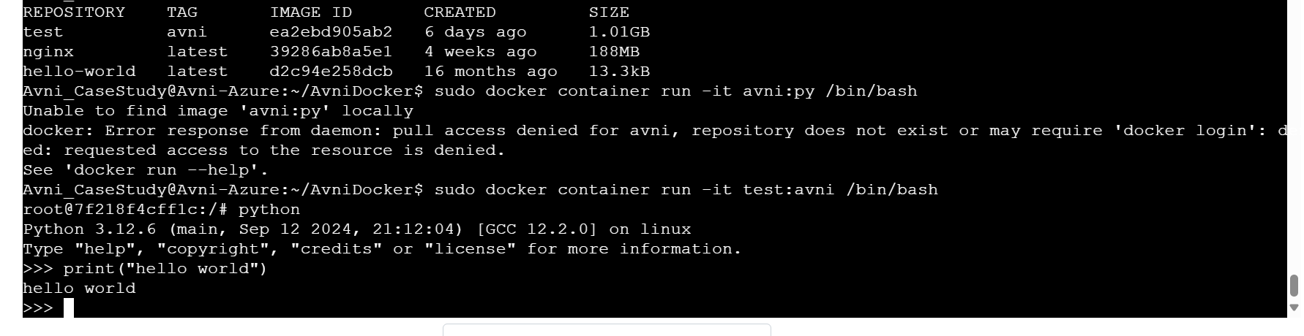

Slide 10

Challenges
Learning Curve
Complexity in Infrastructure
Service Overlap
Cost Management
Security

Slide 11
Thank You

